Slide 1
Full Stack ASP.NET Performance Tuning
Dustin J Ewers
Twitter: @DustinJEwers
Website: www.dustinewers.com
https://github.com/DustinEwers/asp-net-performance

Slide 2

Speak up!
(If you want to…)
Notes:
This is a discussion.
Questions
Comments
Tips

Slide 3
Roadmap
Why?
What?
Scientist Mindset
Data Layer
MVC Layer
UI/Client Side Code

Slide 4
Mindset
Tools
Tactics

Slide 5

Things we’re not going to cover
Hardware
Server Settings
SQL Server Tuning

Slide 6
Why?
Notes:
Do we need to be fast for “lazy entitled millennials” ?
No! There are lots of reasons for quick applications.
Why should you make performance a priority?

Slide 8
Small Performance Improvements = Big Bucks
Walmart – every 1 second of load time = +2% conversion rate
Walmart – every 100 ms = +1% revenue
Staples.com – 1 second = +10% conversion rate
Mozilla – 2.2 seconds = +15.4% downloads

Slide 9
Two hundred and fifty milliseconds, either slower or faster, is close to the magic number for competitive advantage on the Web.
—HARRY SHUM,
EXECUTIVE VP OF TECHNOLOGY AND RESEARCH, MICROSOFT

Slide 10

People hate slow sites
Survey:
71% of people regularly feel inconvenienced by slow web sites
> 30% report increased performance related stress or anger

Slide 11

Slow sites are harder to use
Study:
5mb connection slowed to 2mb
Caused a 50% increase
in required concentration
Notes:
Time is Money – page 20
Concentration Measured by EEG
In 2011, CA Technologies commissioned Foviance, a customer experience consultancy, to conduct a series of lab experiments at Glasgow Caledonian Uni- versity.11 The participants wore an EEG (electroencephalography) cap to monitor their brainwave activity while they performed routine online transactions. Partici- pants completed tasks using either a 5 MB web connection or a connection that had been arti cially slowed down to 2 MB.
Brainwave analysis from the experiment revealed that participants had to concentrate up to 50% more when using websites via the slower connec- tion. When asked what they liked most and least about the websites they used during the study, participants frequently cited speed as a top concern:
Slow sites break flow and cause the user to be stressed.
Think about how this impacts testing and development, as well customer adoption

Slide 12

Do you want this to be your app?

Slide 13

What’s Fast?
0.1 second = Instantaneous
1 second = seamless
1-10 seconds = keeps attention, (Danger Zone!)
> 10 seconds = loss of attention, (Right out!)
Notes:
Time is Money, page 16
Any break in flow is bad news.
These are based on a study from the 90’s

Slide 14
What do people expect?
49% expect load times of 2 seconds or less,
18% expect pages to load instantly
Notes:
Time is Money, page 12

Slide 15
Can I cheat?
Progress bars
Spinners
Progressive loading of content
Notes:
Spinners make apps seems 10% faster

Slide 16
Think like a Scientist!

Slide 17

Scientist Mindset
1. Gather Baseline Data
2. Run an experiment
3. Compare the results to your baseline
4. Repeat until speedy.
Notes:
By Source (WP:NFCC#4), Fair use, https://en.wikipedia.org/w/index.php?curid=44986951

Slide 18
Tests
Unit Tests / Integration Tests
UI Tests
Load Tests
Notes:
Unit / Integration tests for correctness
UI Tests for correctness and single thread load analysis
Load tests – Try to simulate user action.

Slide 19
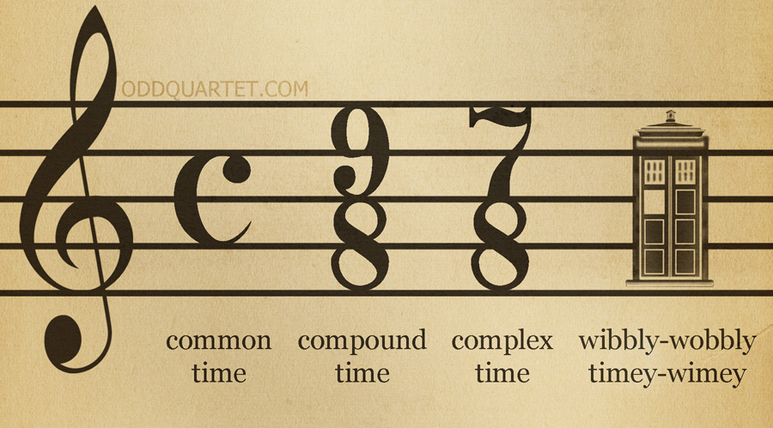
Keeping Time
Notes:
Let’s talk a little about keeping time

Slide 20
Tracking Performance
Individual Performance
VS.NET Profiler
Miniprofiler
Stackfy Prefix
Aggregate Performance
New Relic
Perfmon
Stackfy APM
Notes:
https://technet.microsoft.com/en-us/magazine/2008.08.pulse.aspx

Slide 21
Change only 1 thing at a time!
Notes:
Use short iterations if possible.

Slide 22
Compare | Evaluate | Repeat
Notes:
Repeat until speedy.

Slide 23

Data Layer
Notes:
Primarily focus on Entity Framework

Slide 24
Demos
Notes:
Mini Profiler
Entity Framework Query optimization
- Talk about getting the data that you need

Slide 25

When you see someone get a whole 50 item object graph for a five field grid...
Notes:
Overuse of design patterns leads to situations where you call something that triggers a ton of spurious data access.
i.e. calling a whole transaction object for a few fields.
Mention builder pattern overuse
Mention Cargo Cult programming – including patterns just ‘cause

Slide 26
Data Caching
Lots of tools – Redis, Ncache, Memory Cache
Be smart about cache expiration
Put all of your caching in one layer
You want to cache things that are hard to get and/or don’t change.

Slide 27

MVC Layer
Notes:
MVC Layer is the middle of the stack. Like the cream filling of an Oreo

Slide 28
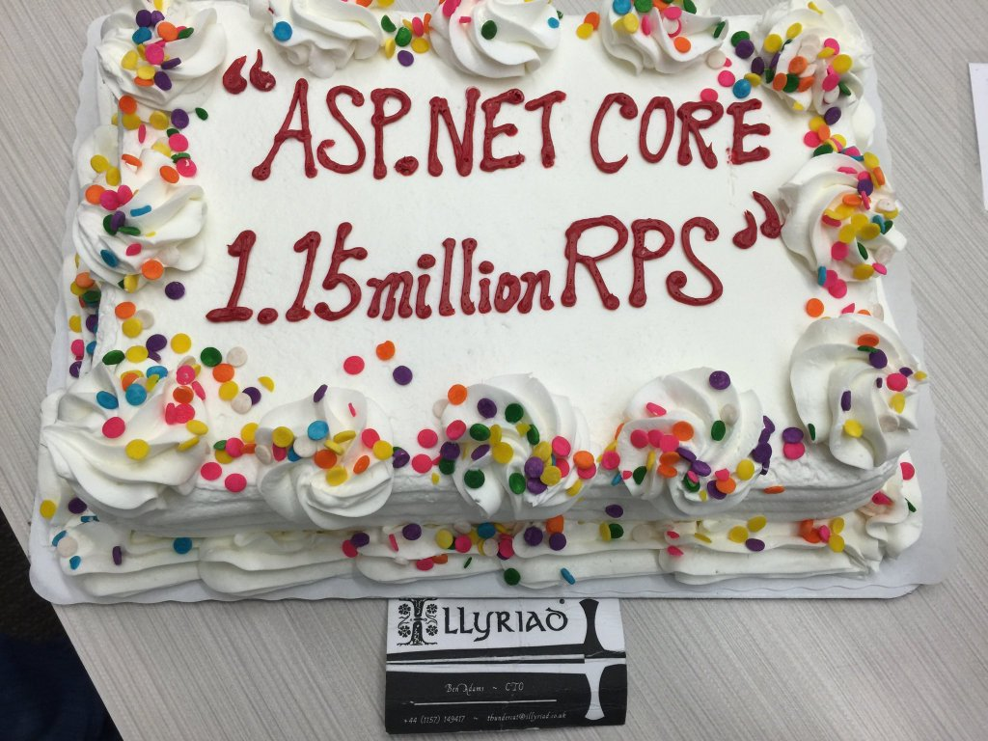
Notes:
Upgrade if you can!
ASP.NET Core is way faster than previous versions
Upwards of 2300% faster (if you believe the benchmarks)

Slide 29
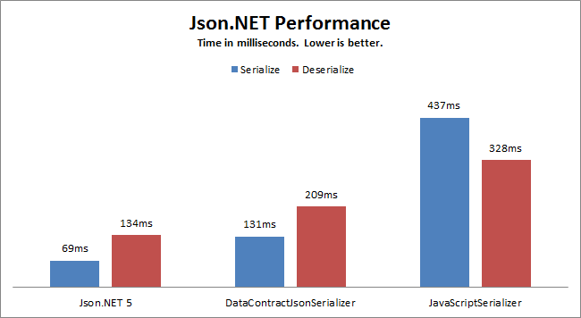
Serialization
Notes:
- Serialization can really add up in modern architectures
- Not all serializers are created equal, and the out of the box ones aren’t all that great.
Watch out for complex entities. They can trash your serialization performance
You’re not going to see this until you start heaping on the load.

Slide 30

Be Careful About What You Log
Perhaps we should turn down
the logging level…
Notes:
Excessive production logging is a “career limiting move”

Slide 31
More Demos
Notes:
Async Demo
Session Locking
Reducing View Engines

Slide 32
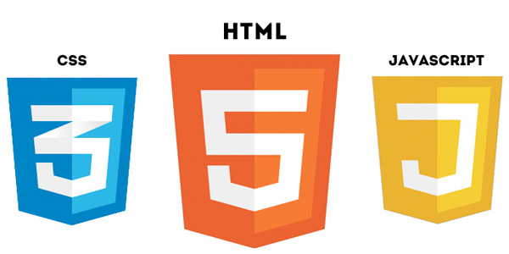
Client Side Layer

Slide 33
Bundling and Minification (JS and CSS)
Why?
Reduce file size
Reduce the number of requests
Easier to Cache
How?
ASP.NET Bundle Files
Gulp
Bundler and Minifier Extension
Notes:
Reduce the number of assets your app pipes down
https://visualstudiogallery.msdn.microsoft.com/9ec27da7-e24b-4d56-8064-fd7e88ac1c40

Slide 34
Dealing with Images
What?
Reduce file size
Reduce the number of requests
Serve them from fast servers
How?
Shrinking your images
Image sprites
Icon Font (Glyphicons/Font Awesome)
CDNs
Notes:
Reduce the number of assets your app pipes down
https://visualstudiogallery.msdn.microsoft.com/9ec27da7-e24b-4d56-8064-fd7e88ac1c40

Slide 35
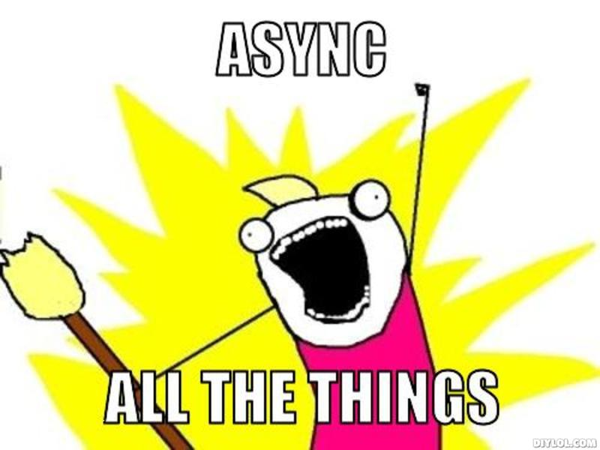
Async… part 2
Notes:
Don’t block the user flow
Use async loading of slow loading content
Use ajax for form submits so the user doesn’t lose page focus.
Client Side Validation – not for security reasons
Try to get a page in front of the user as soon as possible.
The overall goal of all of this is immediate response for the users.

Slide 36
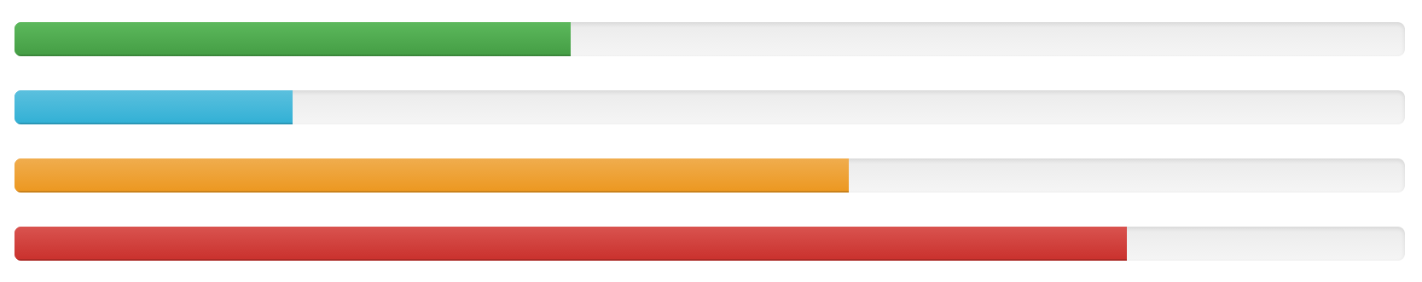


Progress Controls
Notes:
Use spinners and progress bars for long running operations
Can also do async and report back if it’s something that takes a really long time (like an import)
The key is immediate response to the user

Slide 37
Even More Demos
Notes:
Bundling options
Show the Extension and the Bundle Files

Slide 38
Takeaways
Make Performance a Priority (Time = Money)
Think like a scientist. (Measure | Experiment | Repeat)
Be mindful about data access
Async all the things

Slide 39

The Choice is Yours.

Slide 40
Questions?

Slide 41
Full Stack ASP.NET Performance Tuning
Dustin J Ewers
Twitter: @DustinJEwers
Website: www.dustinewers.com
https://github.com/DustinEwers/asp-net-performance

